Slide 1
Open Health Data Visualization
Summer 2015
Review of Potential Web Interfaces

Slide 2
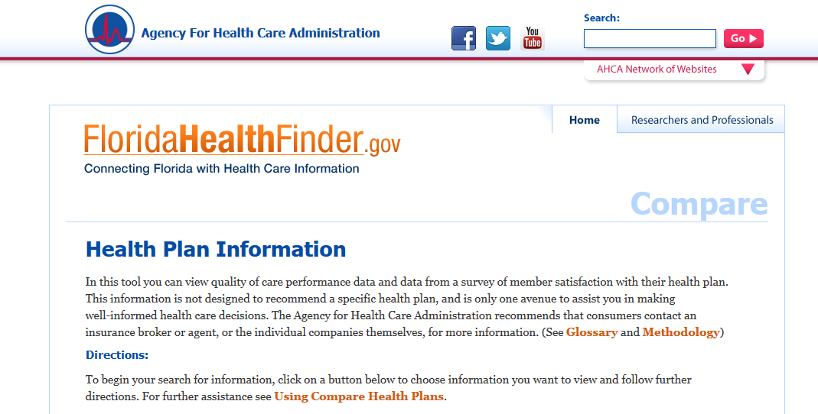
Florida Health Finder
Comparing/Finding Health Plans

Slide 3
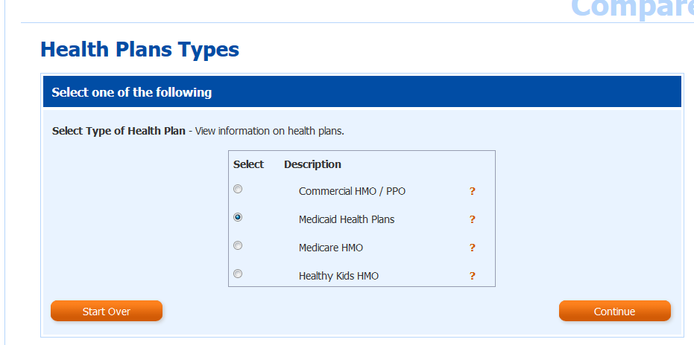
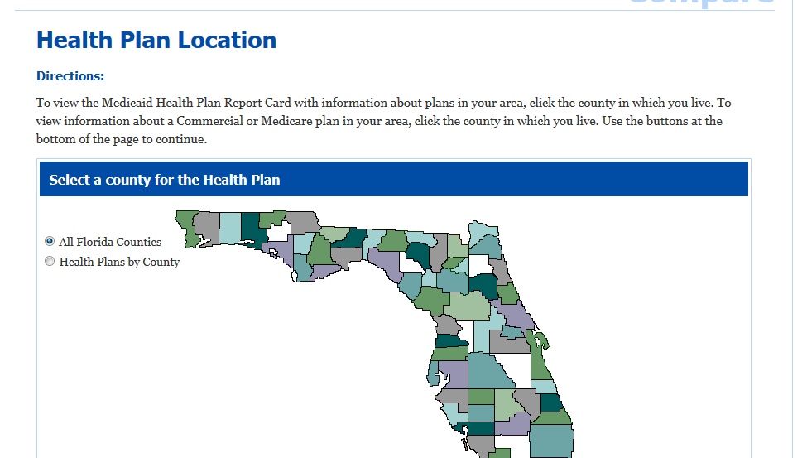
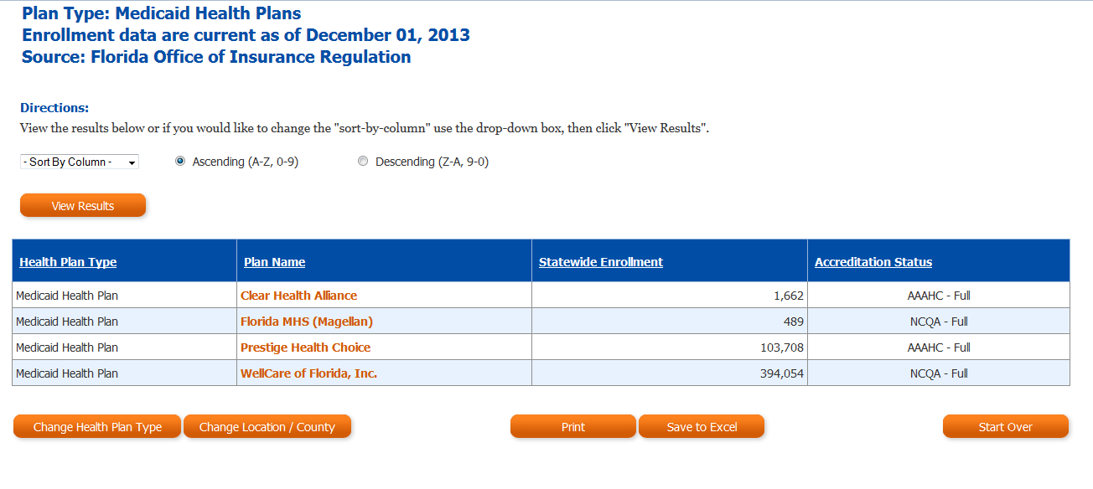

Slide 4
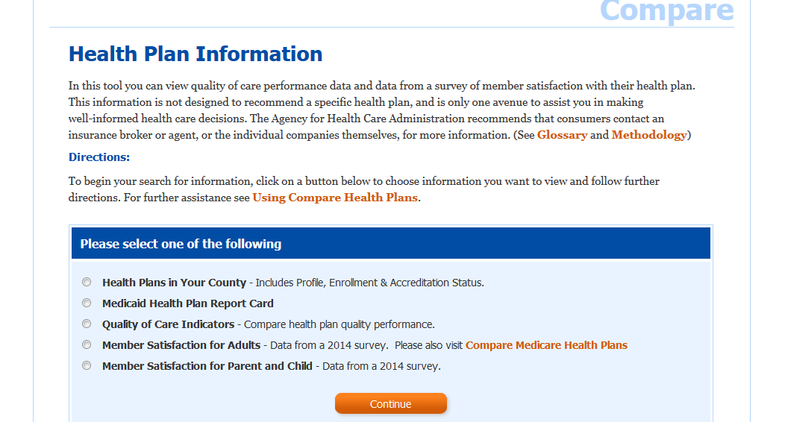
Florida Health Finder
Comparing/Finding Health Plans

Slide 5
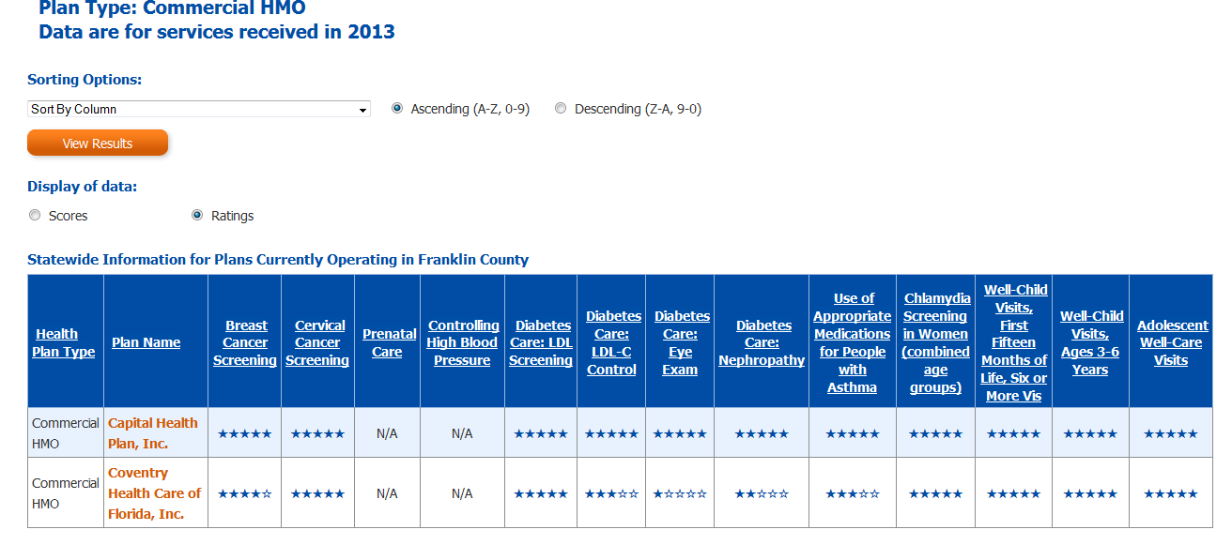
Florida Health Finder
Quality Report Card

Slide 6
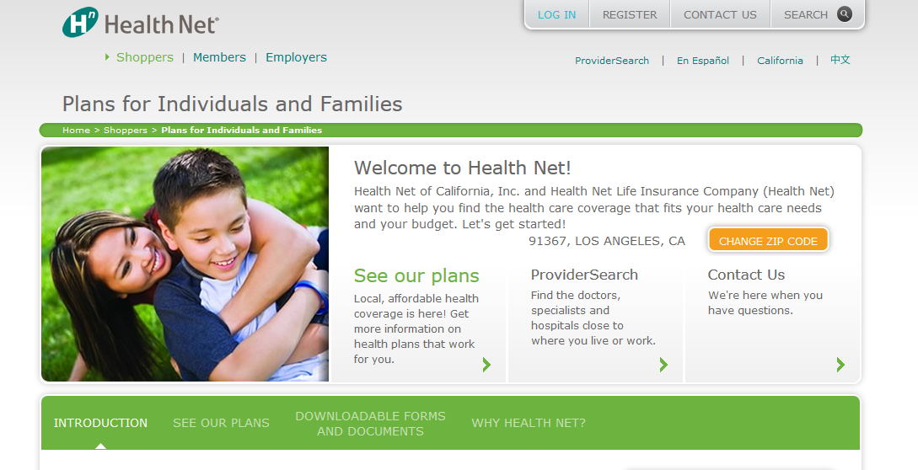
Health Net of California

Slide 7
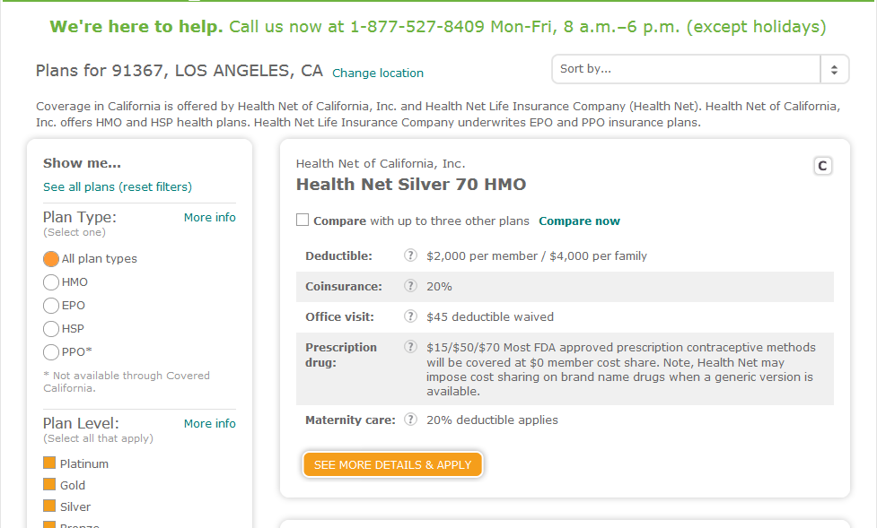

Slide 8
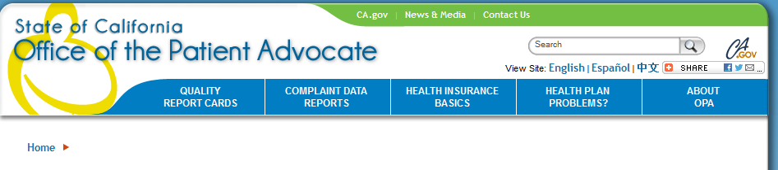
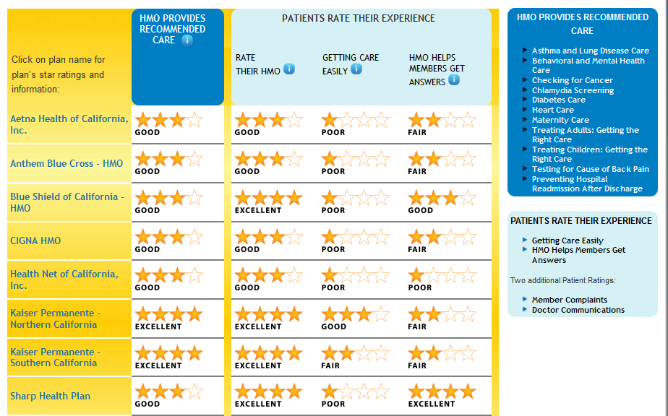
Notes:
http://reportcard.opa.ca.gov/rc/hmoabout.aspx

Slide 9
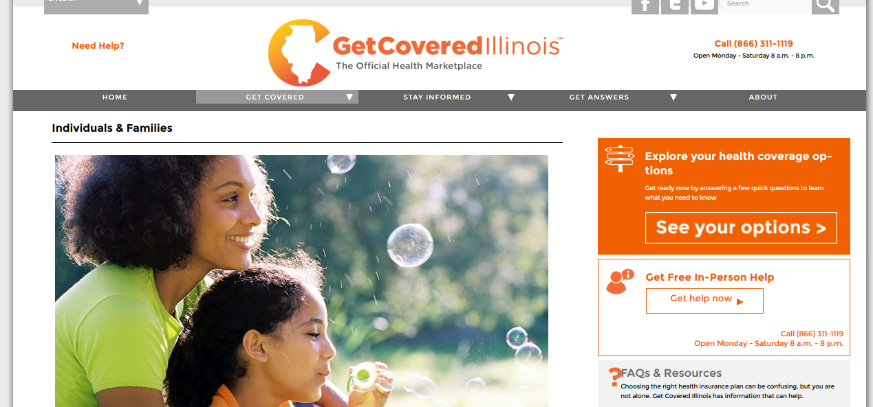
Get Covered Illinois
Notes:
http://reportcard.opa.ca.gov/rc/hmoabout.aspx

Slide 10
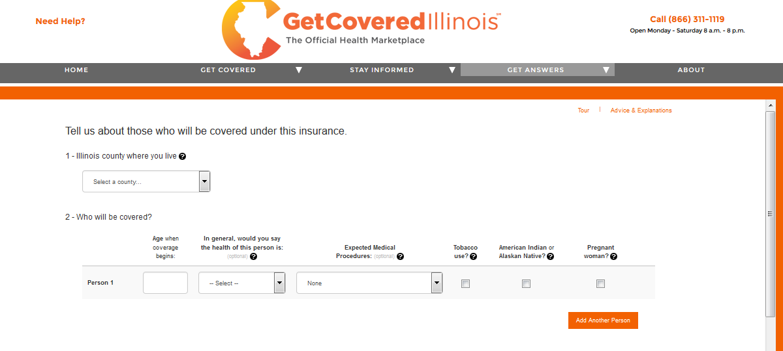
Get Covered Illinois
Notes:
http://reportcard.opa.ca.gov/rc/hmoabout.aspx

Slide 11
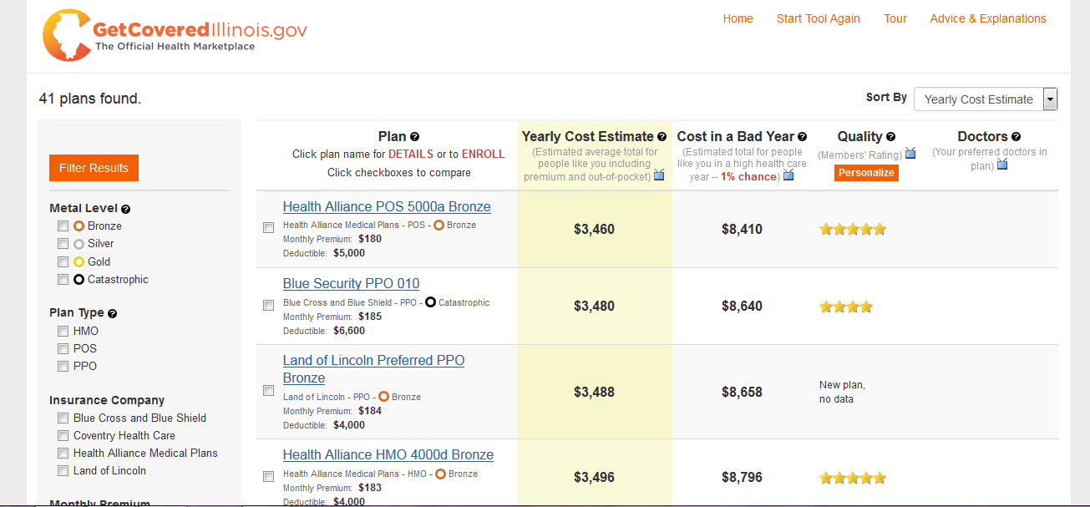
Get Covered Illinois
Notes:
http://reportcard.opa.ca.gov/rc/hmoabout.aspx

Slide 12
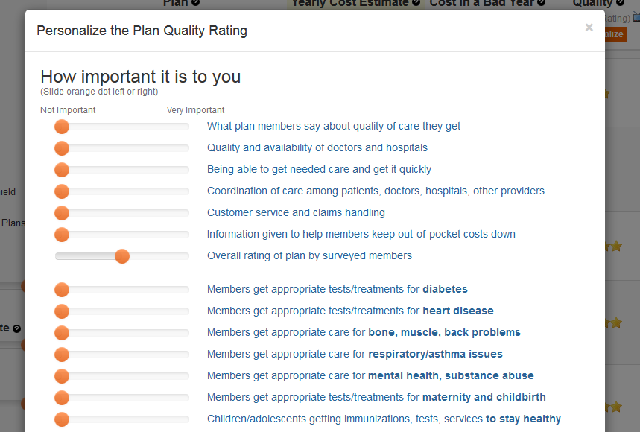
Notes:
http://reportcard.opa.ca.gov/rc/hmoabout.aspx

Slide 13
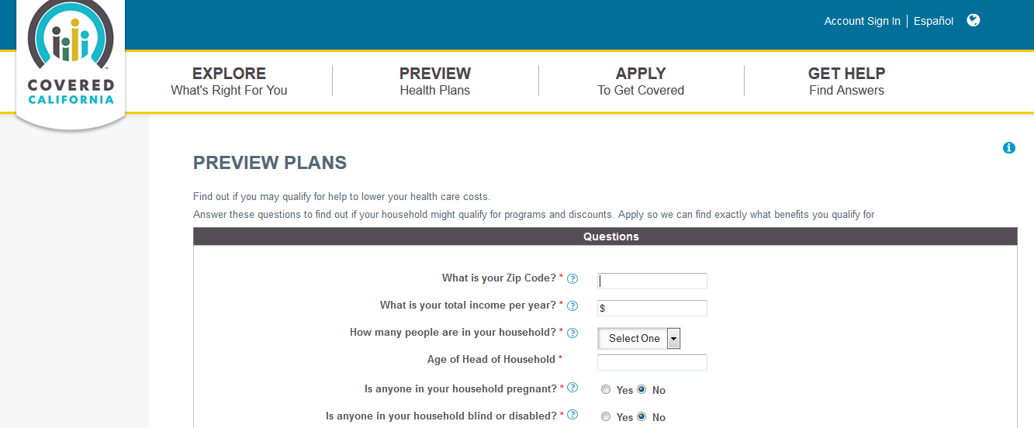
Covered California

Slide 14
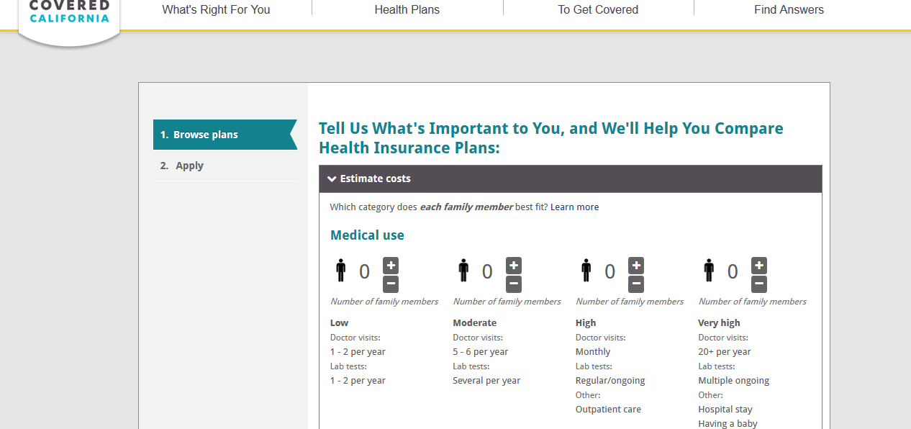
Covered California

Slide 15
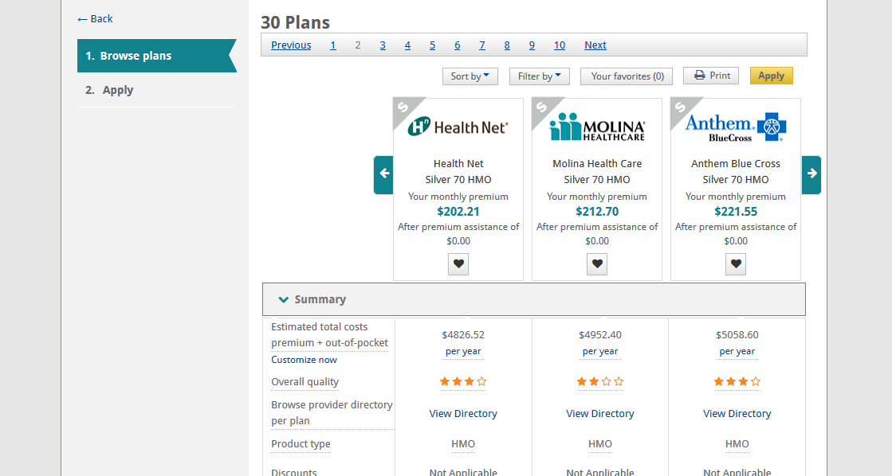
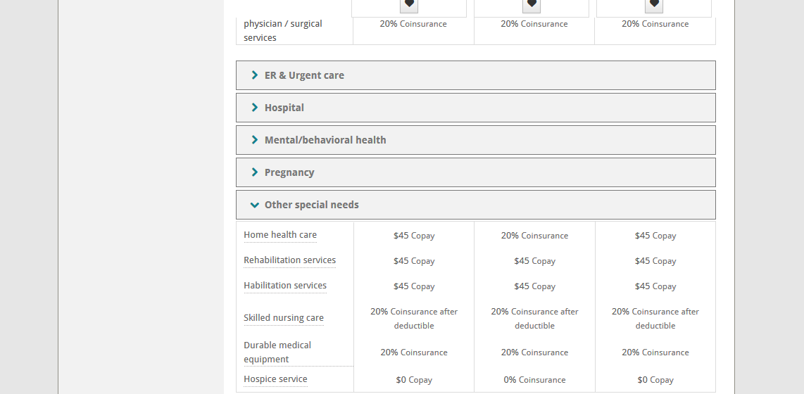
Covered California

Slide 16
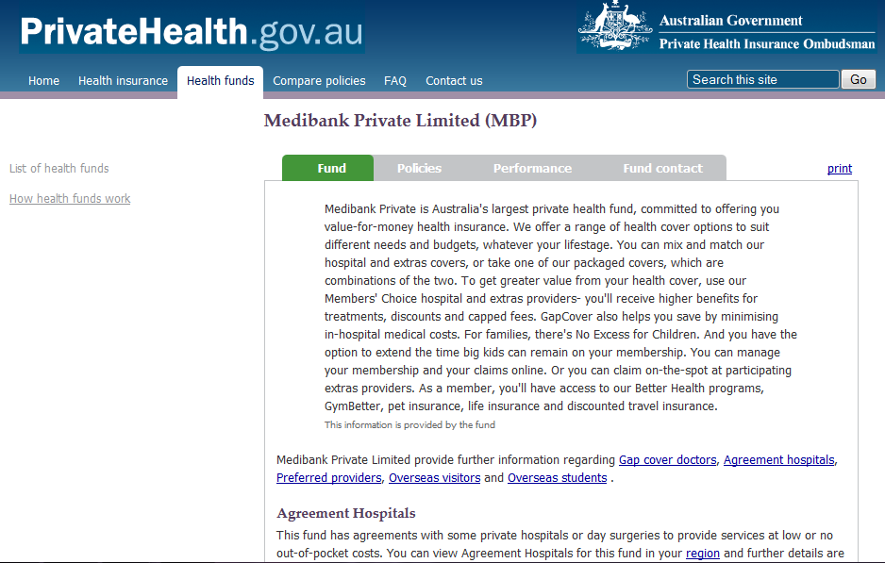
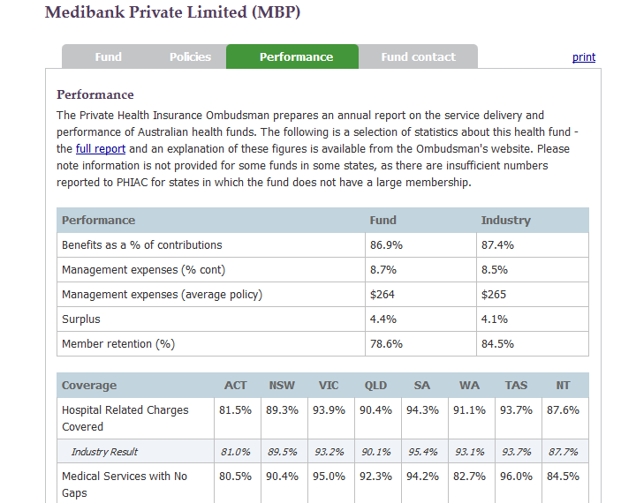
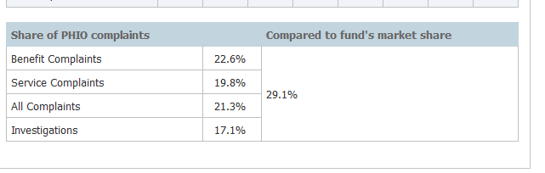

Slide 17
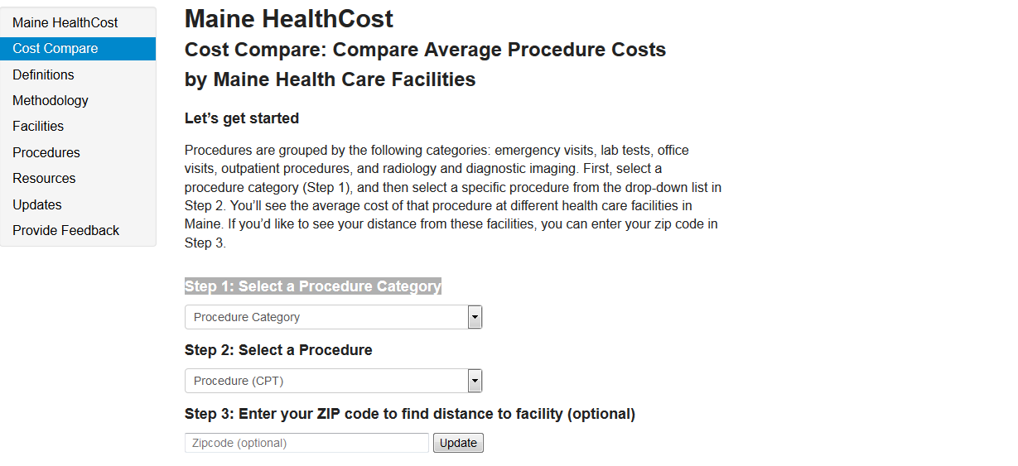
Maine HealthCost

Slide 18
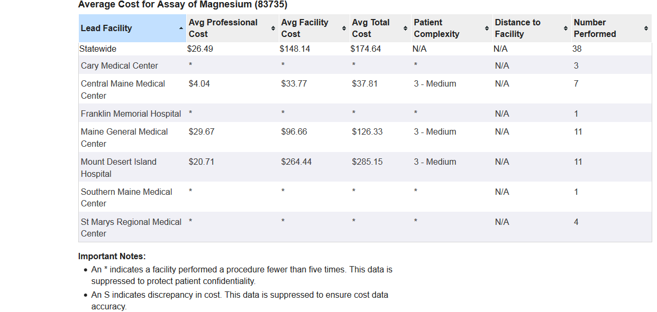
Maine HealthCost

Slide 19
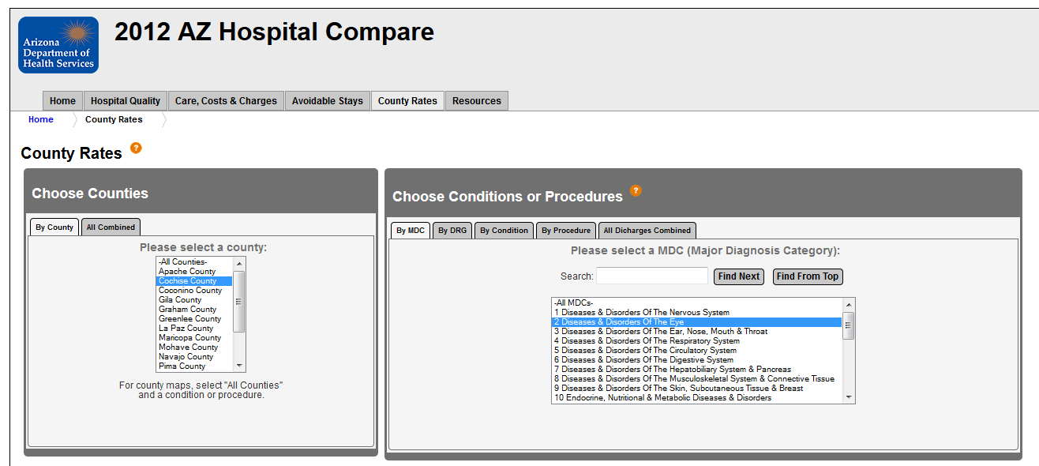
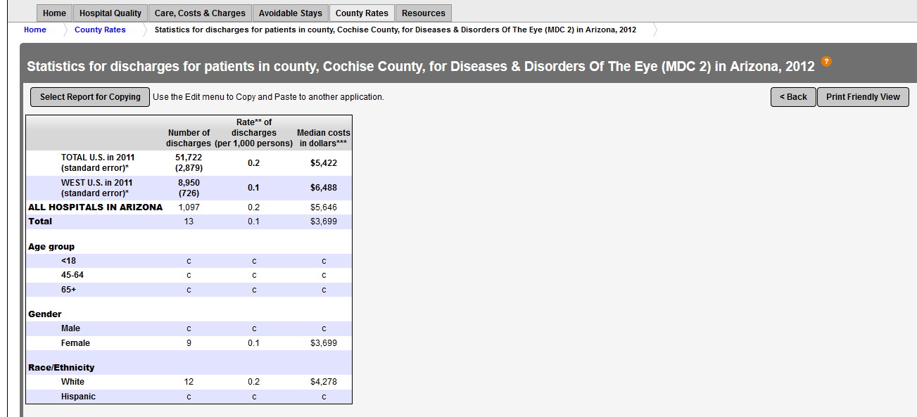
Arizona DOH Services
County Costs

Slide 20
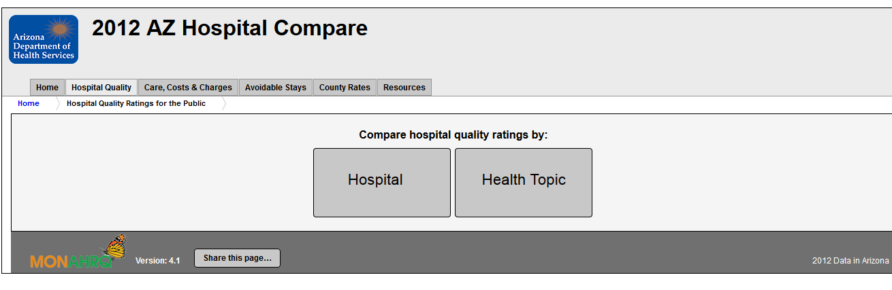
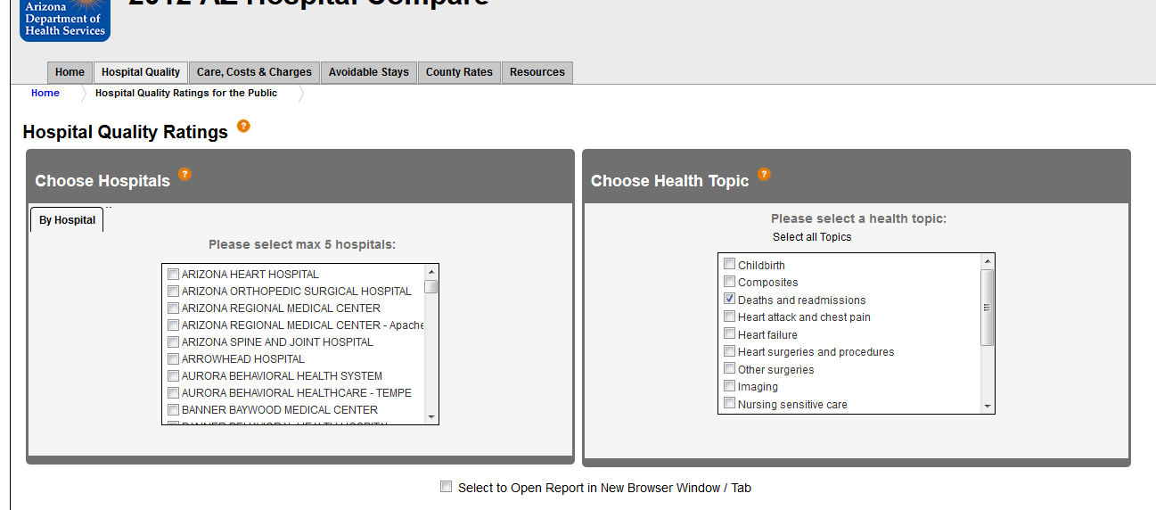
Arizona DOH Services
Hospital Quality

Slide 21
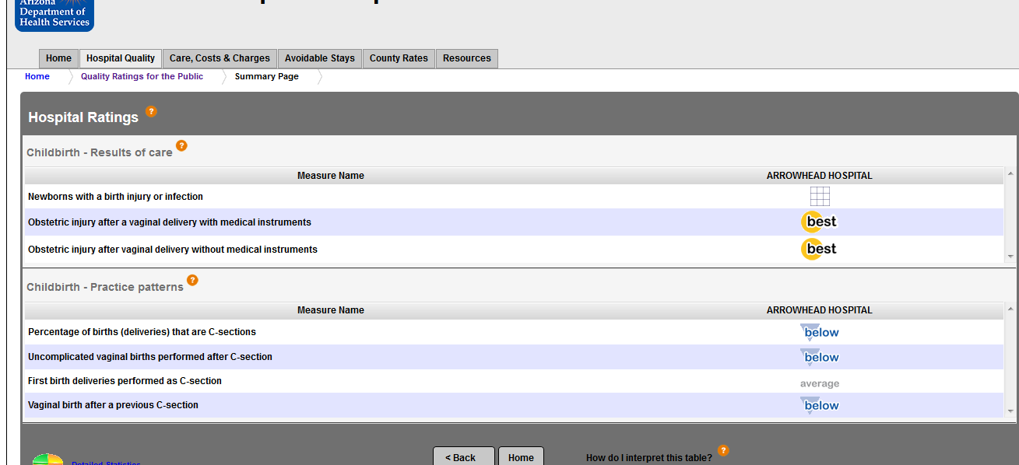
Arizona DOH Services
Hospital Quality

Slide 22
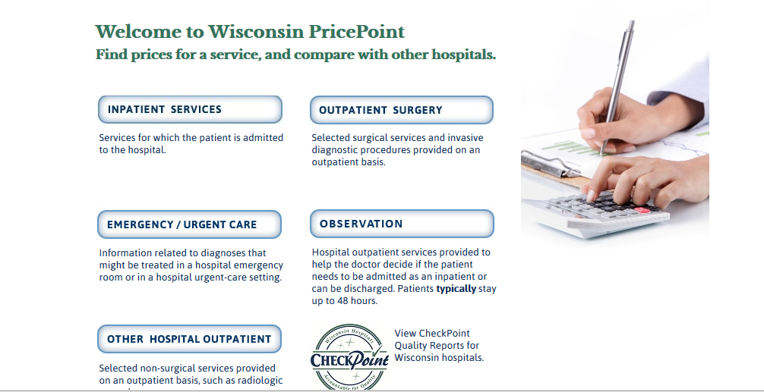
Wisconsin Price Point

Slide 23
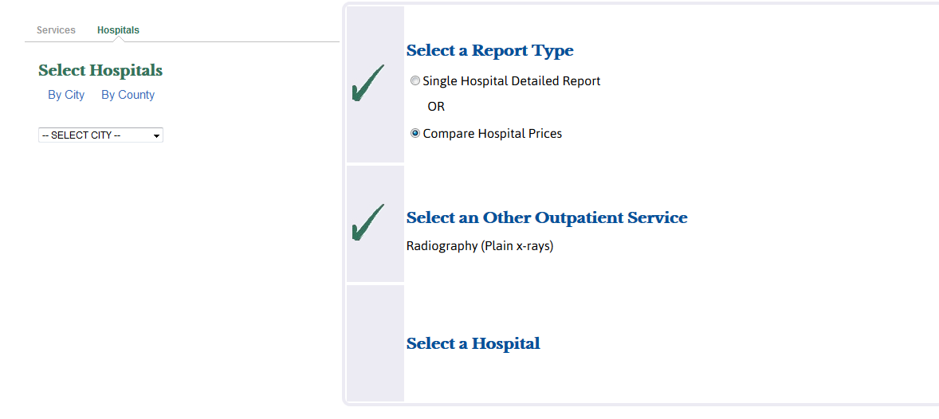
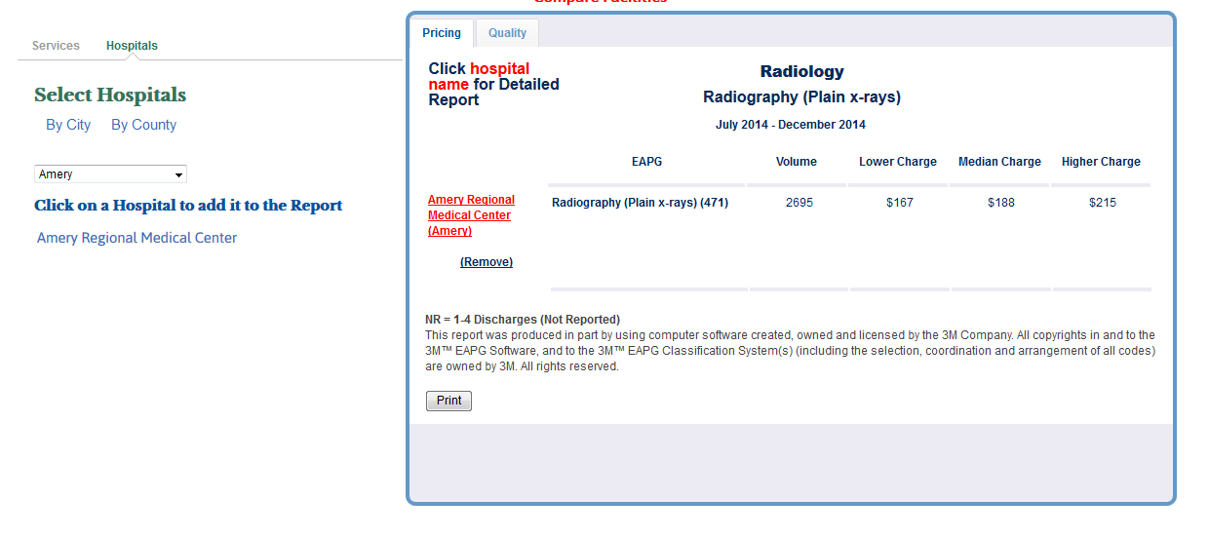
Wisconsin Price Point

Slide 24
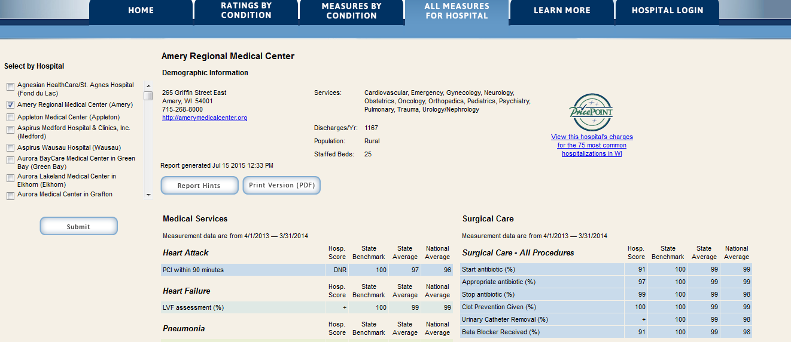
Wisconsin Price Point
Quality Check

Slide 25
Findings
Tutorials
Offer options of different types of searches (county plans, report cards, indicators)
Identifying a persona
Comparison tools
Refining search options within results page
Quality is displayed in percentages or stars but often has some side information describing how that information was found or what metrics were used.
Functions include printing, ‘favoriting’, filtering, sorting, downloading

Slide 26
Recommendations
Tutorials can help users understand the search process
Combination of ‘Creating a Persona’ and navigation options
Allow users to customize their search while the search results are viewable
Provide background information to users that is accessible, identifiable - short and sweet

